Slide 1
Discrete Distributions: (3) Poisson Distribution

Slide 2
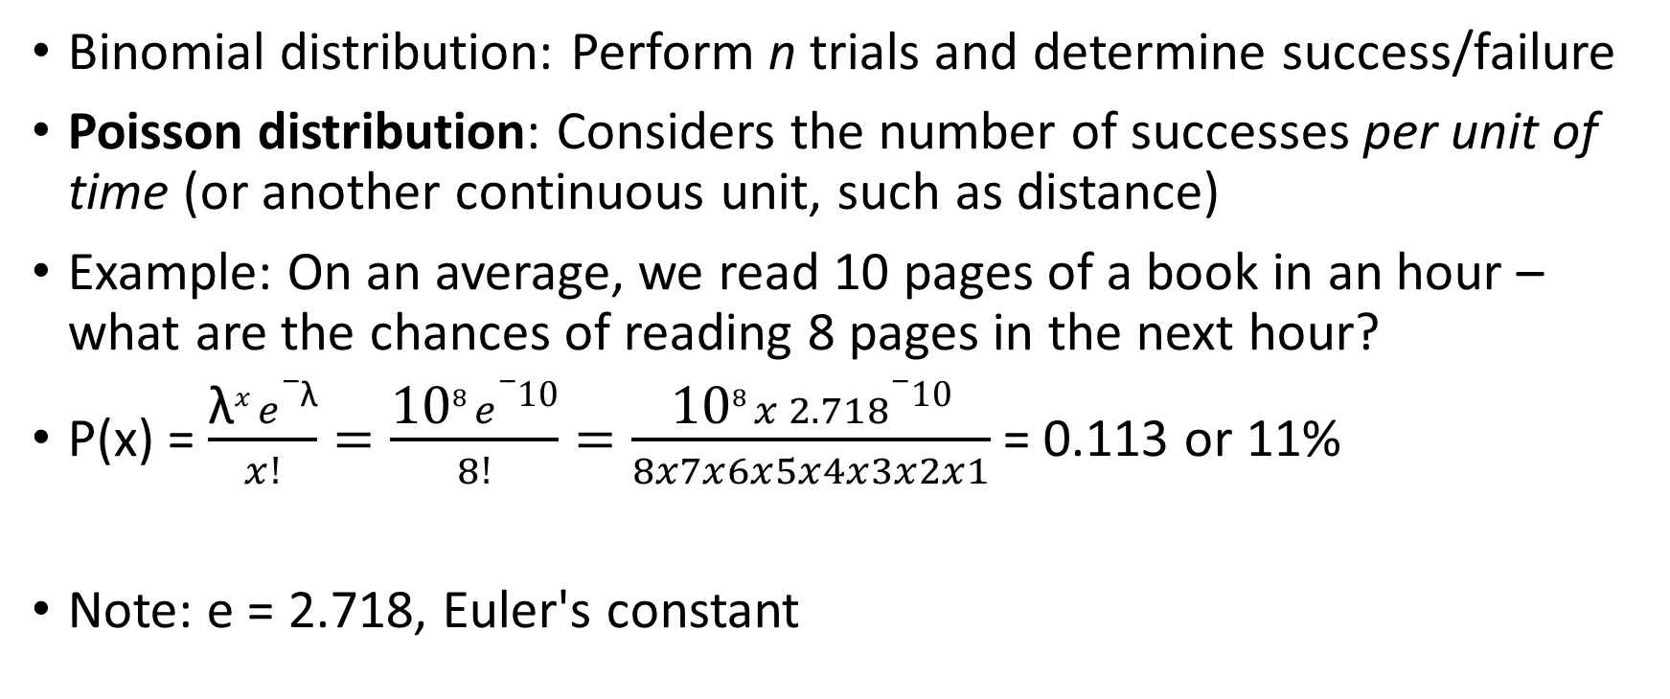
Poisson Distribution
Binomial distribution: Perform n trials and determine success/failure
Poisson distribution: Considers the number of successes per unit of time (or another continuous unit, such as distance)
Example: On an average, we read 10 pages of a book in an hour – what are the chances of reading 8 pages in the next hour?
P(x) = $\frac{\text{λ}x e−\text{λ}}{x!}=\frac{\text{10}8 e−\text{10}}{8!}=\frac{\text{10}8 x 2. 718−\text{10}}{8x7x6x5x4x3x2x1}$ = 0.113 or 11%
Note: e = 2.718, Euler's constant

Slide 3

Poisson Distribution
Example: Usually 15 cars pass a toll plaza every hour. We want to know the probability that 13 cars will pass through in the next hour.
P(x) = $\frac{\text{λ}x e−\text{λ}}{x!}=\frac{\text{15}13 2.718−\text{1}5}{13!}=\frac{\text{10}8 x 2. 718−\text{10}}{8x7x6x5x4x3x2x1}$ = 0.0956 or 9.56%

Slide 4
Poisson Distribution – Code
C:\code\Data Analytics\poisson_distribution.py
C:\code\Data Analytics\poisson-retail-transactions.py
Assignment: For Amazon Sale Report data:
Find the average monthly items sold for January to December separately
For each month, find the probability of selling the average +/- 5 products using Poisson distribution
Visualize results

Slide 5
Continuous Distributions: Normal Distribution

Slide 6
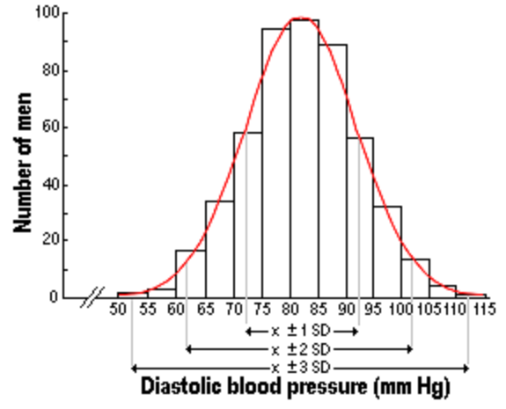
Real life and Normal Distribution
Many real-life data points follow Normal Distribution:
People’s heights and weights
Population blood pressure
Test scores
Also called as Gaussian Distribution
Generally, less/non-natural phenomena do not have normal distributions, e.g. income of people

Slide 7
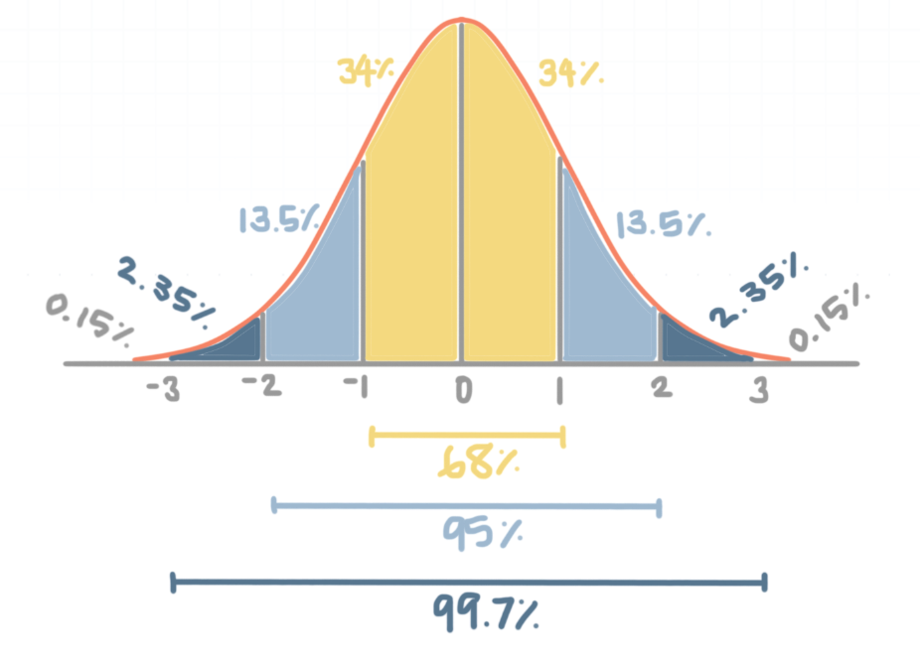
Normal Distribution: Key Features
Symmetry: Perfect symmetry around the mean
Mean = Median = Mode = Center point of the normal distribution
Bell-shaped curve
Empirical rule:
68% of the data falls within Mean ± 1 SD
95% of the data falls within Mean ± 2 SD
99.7% of the data falls within Mean ± 3 SD
Z-score (Standard score): Useful in finding relative position of an observation with respect to the overall population

Slide 8
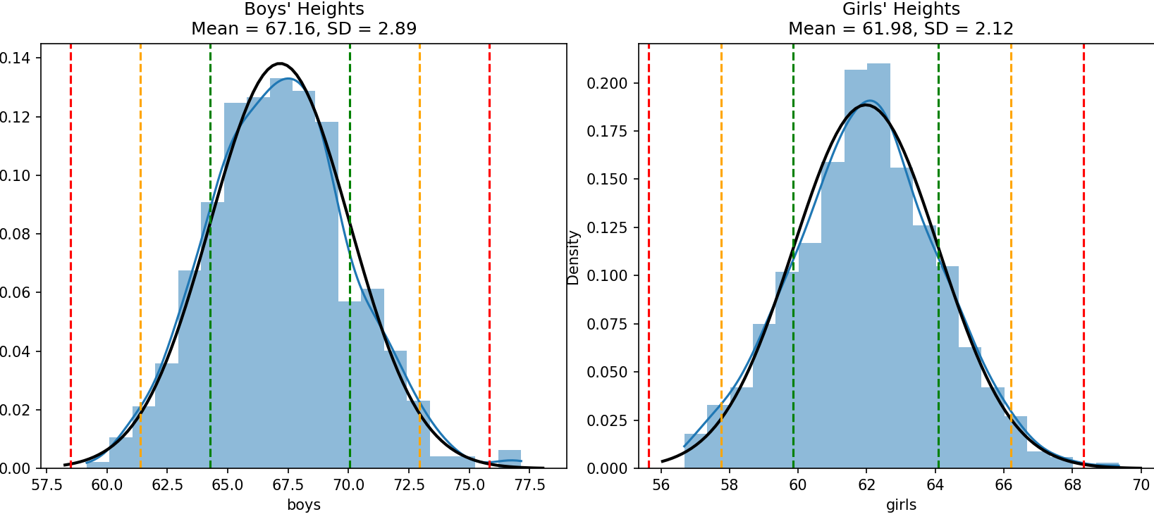
Example: Student Heights (C:\code\Data Analytics\normal_distribution.py)

Slide 9
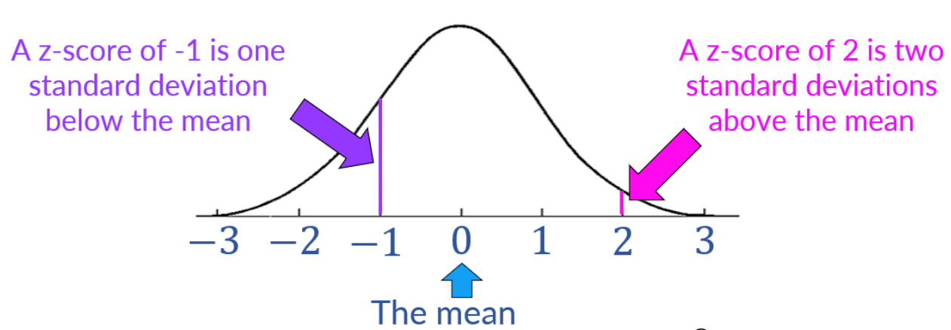

Z-Score Calculations
Z-Score (Standard Score): Describes how many standard deviations away a data point is from the mean
$\text{Z}\text{-}\text{Score}= \frac{x − μ}{σ}$
x: individual data value
μ: population mean
σ: population standard deviation
Z-scores > +3 and < -3 are considered outliers

Slide 10
Z-Score: Problem
A runner participated in a 200m race and a 500m race
Consider the following, calculate Z-scores and determine where she did better
Race | Average time | Standard deviation | Runner’s time
200m | 31s | 1.5s | 28s
500m | 125s | 8.2s | 132s

Slide 11


Z-Score Example
A runner participated in a 200m race and a 500m race
Consider the following and determine where she did better
Race | Average time | Standard deviation | Runner’s time
200m | 31s | 1.5s | 28s
500m | 125s | 8.2s | 132s
200m
$$Z= \frac{X − μ}{σ}=\frac{28 −31}{1.5}=−2$$
500m
$$Z= \frac{X − μ}{σ}=\frac{132 −125}{8.2.}=0.854$$

Slide 12
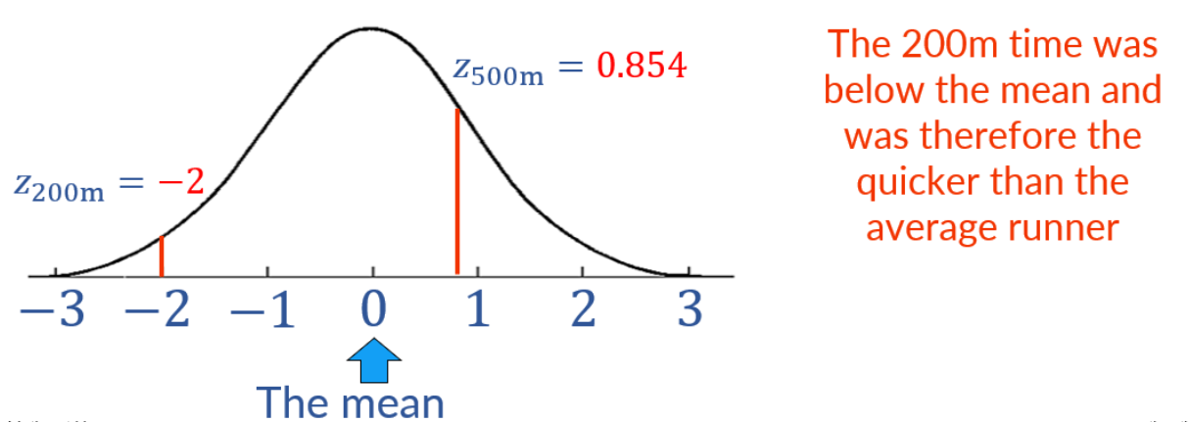
Visualizing Z-Scores
In other examples, positive/higher Z-score will be better, e.g. marks obtained by a student – Because, here the student would want to be above average
In this example, a lower time would be preferable when completing a race and so, the lower z-score would be better

Slide 13
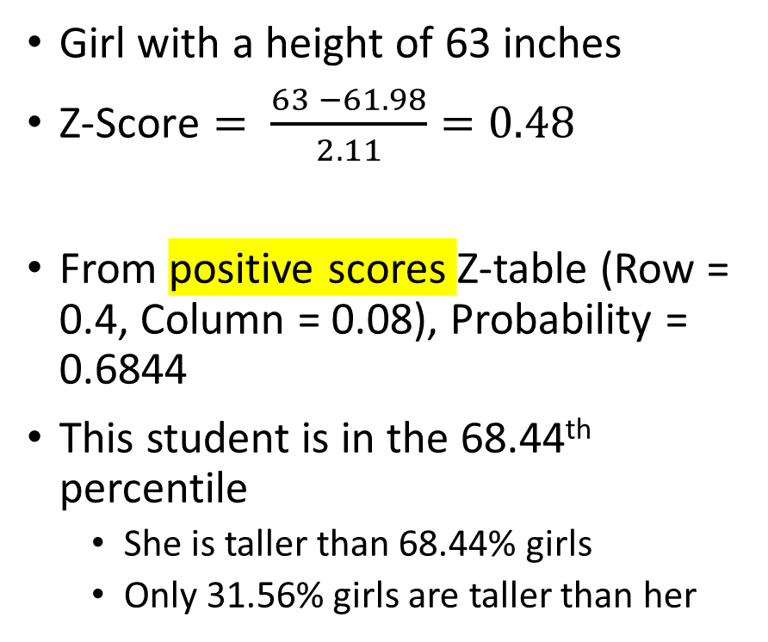
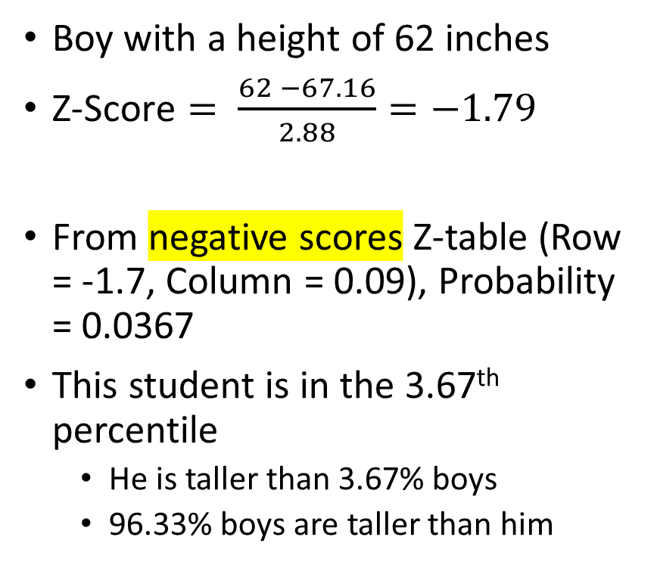
Student Example: Z-Scores, Probabilities, Percentiles
Boy with a height of 62 inches
$\text{Z}\text{-}\text{Score}= \frac{62 −67.16}{2.88}=−1.79$
From negative scores Z-table (Row = -1.7, Column = 0.09), Probability = 0.0367
This student is in the 3.67th percentile
He is taller than 3.67% boys
96.33% boys are taller than him
Girl with a height of 63 inches
$\text{Z}\text{-}\text{Score}= \frac{63 −61.98}{2.11}=0.48$
From positive scores Z-table (Row = 0.4, Column = 0.08), Probability = 0.6844
This student is in the 68.44th percentile
She is taller than 68.44% girls
Only 31.56% girls are taller than her

Slide 14
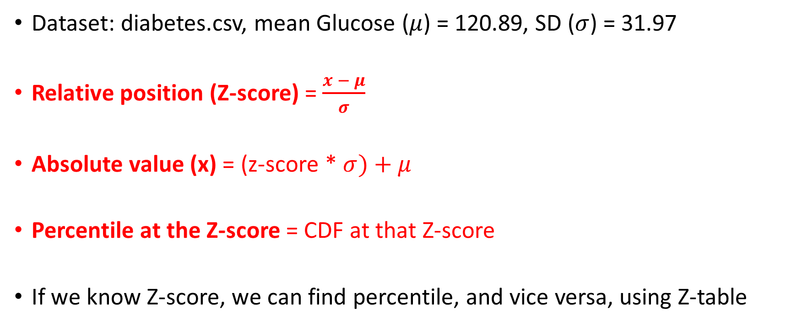
Three Important Measurements
Dataset: diabetes.csv, mean Glucose ($μ$) = 120.89, SD ($σ$) = 31.97
Relative position (Z-score) = $\frac{x − μ}{σ}$
Absolute value (x) = (z-score * $σ)+μ$
Percentile at the Z-score = CDF at that Z-score
If we know Z-score, we can find percentile, and vice versa, using Z-table

Slide 15
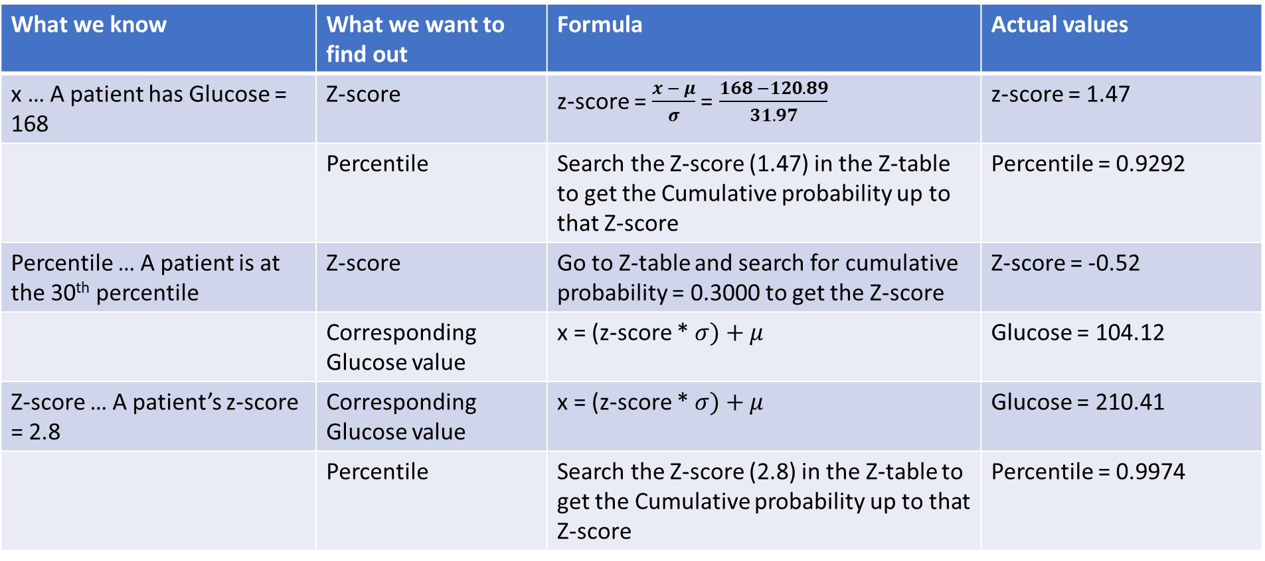
Examples (z_score_diabates.py)
Dataset: diabetes.csv, mean Glucose = 120.89, SD = 31.97
What we know | What we want to find out | Formula | Actual values
x … A patient has Glucose = 168 | Z-score | z-score =$\frac{x − μ}{σ}$ = $\frac{168 −120.89}{31.97}$ | z-score = 1.47
 | Percentile | Search the Z-score (1.47) in the Z-table to get the Cumulative probability up to that Z-score | Percentile = 0.9292
Percentile … A patient is at the 30th percentile | Z-score | Go to Z-table and search for cumulative probability = 0.3000 to get the Z-score | Z-score = -0.52
 | Corresponding Glucose value | x = (z-score * $σ)+μ$ | Glucose = 104.12
Z-score … A patient’s z-score = 2.8 | Corresponding Glucose value | x = (z-score * $σ)+μ$ | Glucose = 210.41
 | Percentile | Search the Z-score (2.8) in the Z-table to get the Cumulative probability up to that Z-score | Percentile = 0.9974

